Slide 1


GIFT City Treasury Centre
Positioning for growth in the new era

Slide 2
Treasury Centre Trends

Slide 3
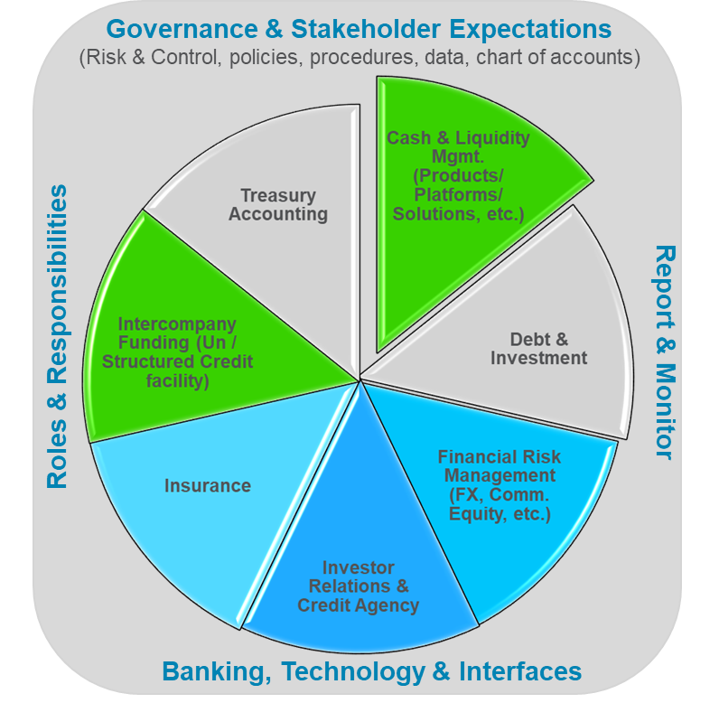
Why MNCs require an international treasury centre: Challenges for today’s Treasury and the critical role of RTC
#1 Respond to an era of prolonged high interest rate. Idle cash has a cost. Higher expectation for RTC to do more to improve cash KPI.
#8 Respond to market disruption risk: Expect the unexpected - counter-party exposure, cyber-attack, currency loss, sanction risk and FX control.
#2 Respond to demand down cycle when inventory/receivable are expected to lock up more cash. RTC can free up cash.
#7 Respond to the shift of global supply chain demands a new South Asia/ASEAN cash strategy to address trapped cash.
#3 Respond to pressure to de-leverage to support future dividend and capex commitment.
#6 Respond to digital transformation a game-changer. RTC needs to be fit for purpose to support more real time cash visibility, payment control and cash allocation.
#4 Respond to costly and complex global tax regime (Base Erosion and Profit Shifting or BEPS) on transfer pricing compliance. RTC can simplify and reduce tax compliance cost.
#5 Respond to opportunity to migrate to more powerful treasury technology (e.g., SAP S/4HANA) to support IHB accounting.
¹ QE is quantitative easing and QT is quantitative tightening. US Federal Reserve raised federal funds rate from 0.25% (Q2 2022) to a 22-year high of 5.25-5.5% (Q3 2023)

Slide 4
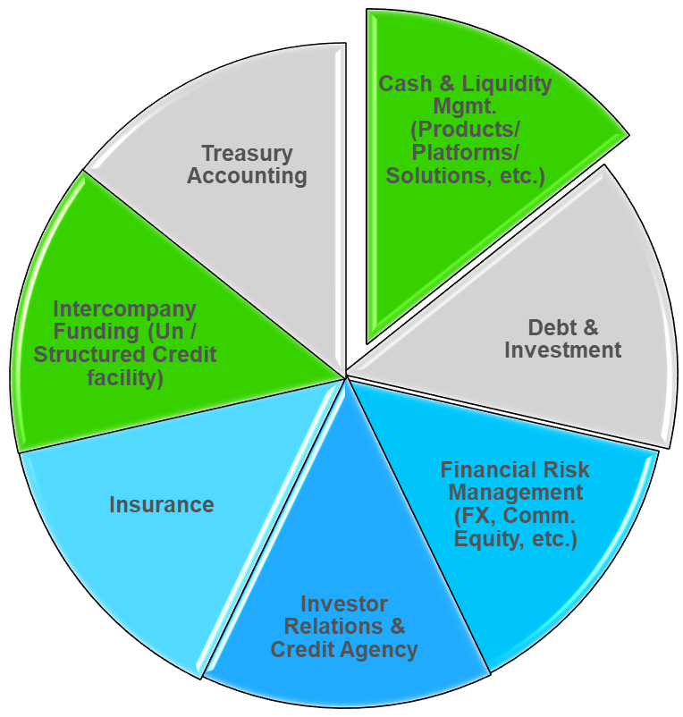
What to focus for MNCs: Industry’s RTC agenda & expectations from Today’s Treasury
Agenda
Today’s Treasury
Expectations
RTC agenda #1 – Sustainable growth via In-House Bank
Governance & Stakeholder Expectations
(Risk & control, policies, procedures, data, chart of accounts)
Centralize treasury: OBO payment factory and IHB netting gaining traction ²
Generate IHB bank statement, Segregate Op-co transactions; Digitise BEPS interest/tax calculation
RTC agenda #2 – Treasury technology infrastructure
Automated posting of journal entries in IHB and Op Co books ; OECD Transfer Pricing Documentation on parent guarantee and inter-company lending
RTC agenda #3 – Towards real time
Real time reporting & dashboarding, liquidity and payments and collections¹
Favourability for API 86 percent, RPA 80 percent, Machine learning and AI 56 percent, Blockchain 40 percent ³
Roles & Responsibilities
Report & Monitor
RTC agenda #4 - Automation
Swift ISO 20022 messaging expected to bring in richer payment advice data to support STP
RTC agenda #5 – digital payment
Real time payment schemes in around 70 markets are providing high speed payment rails⁴
Intra-Asia payment corridors and Cross-region gateway (the m-Bridge CBDCº ) are gaining traction
RTC agenda #6 – Future technology adoption
As blockchain application tends to work in an ecosystem environment, co-creation approach is commonly used with banks/fintech providers.
Banking, Technology & Interfaces
Trends are echoed in the three Global Treasury Survey conducted by ¹ EACT (2023) , ² PwC (2023), ³Deloitte (2022) and ⁴ FIS Global Payment Report 2023
ºCBDC – Central bank digital currency

Slide 5
What is the right Treasury Framework

Slide 6
Treasury Centre is the tool and platform to achieve best execution
At the same time, we need to do it well (efficiency) and do it right (compliance)
Funding
Liquidity Mgt
Risk Mgt
Working Capital
Netting
Cash
Mgt
Banks
Source Services/Funding
Operating companies
Provide Services
In-house Bank
Investors, Treasury Service Providers
Future Treasury Model Characteristics:
Zero idle cash - just right to lubricate (not flood) the engine, allocate more for reserve (for capex and M&A to grow, for inventory to defend and for dividend to return value to investors)
Liquidity without boundary (able to combine the use of domestic and overseas cash)
Real time Treasury (both visibility and movement of cash)
Data-driven: augmented by technology tools like AI
Full payment/liquidity/FX netting
Four Quadrants of Success:
Netting of internal liquidity to minimise debt cost by recycling internal cash through intra-group financing
Netting of intra-group payment to reduce unnecessary flow, payment cost and FX cost
Netting of external payment to cut cash buffer and achieve better efficiency
Netting of FX exposure to minimise hedging costs using “natural hedging” and notional pooling

Slide 7
The Building Block of Treasury Centre – Policy, Process, Product and People
Treasury Centre Design
Governance (Policy and ALCO) | Organisation (COE) | Process, R&R | Performance KPI
Cash and Liquidity Management
Roles | KPIs
Payment and collection Deploy internal cash to reduce cost of funding Improve cash conversion cycle Minimize liquidity risks Simplify cash forecasting and planning Yield enhancement and cash allocation strategy End-to-end straight through processing from ERP and TMS systems Maintain bank relations on group wide basis | Level of free cash Amount of working capital released Total pooling balance offset Number of accounts per entity Number of accounts with non-core bank partners Interest yield Overdraft cost Time to reconcile Straight through processing rate
Treasury Risk Management
Roles | KPIs
Manage foreign exchange, interest rate, and commodity risks on a group wide basis to achieve best execution and use natural hedging to reduce hedging cost Automated trade confirmation and settlement | FX and commodity cost Hedge effectiveness between actual executed rate vs market rate Rate of automation in confirmation and settlement % exposure eliminated by IHB vs total exposure % VAR reduction on P&L due to FX offset
Financing
Roles | KPIs
Lower financing costs and refinancing risks by leverage group bargaining power and rating Optimize the use of banking facilities Reduce duration mismatch risk and asset/liability management risk as projects have long payback Manage investor and credit rating agency relations | Lower borrowing cost Ability to gain visibility into all exposures and to identify available headroom in counter-party usage
Treasury Centre Infrastructure:
Compliance (Regulatory, Tax, Accounting) | Technology Platform (TMS/SWIFT/RPA) | Bank Product(s) & Account Structure

Slide 8
The 1st port of call: To arrive at a right cross border pooling structure
Treasury Centre performs the role of intra-group financial intermediate or “in-house bank” on four inter-company treasury functions a) liquidity management (LM), b) foreign exchange, c) payment and d) netting.
LM Structure (1)
LM Structure (2)
LM Structure (3)
Onshore
location
Onshore
location
RTC
Onshore
location
RTC
RTC
LP NRA
LU NRA
RTC NRA
RTC NRA
Offshore market(s)
Offshore market(s)
Offshore market(s)
Liquidity provider
Liquidity user
Liquidity provider
Liquidity user
Liquidity provider
Liquidity user
Cross border
intra-group financing
Onshore
intra-group financing
Offshore
intra-group financing
Remark: Liquidity user can be a domestic subsidiary

Slide 9
The 2nd port of call: (now the cash is in IFSC) To have the cake and eat it
Physical pooling vs notional pooling (using LM structure (2) for illustration
TC as
Pool Header
TC as
Pool Header
Inter-company
deposit or
ICD
Inter-company
loan or
ICL
Liquidity management bank
+ Plain vanilla
bank deposit/loan
LP NRA
LU NRA
+ LU India co.
LP NRA
LU NRA + LU India co.
Physical cash pooling
Notional cash pooling
Comparison | Physical pooling as LM tool | Notional pooling as LM tool
Tax consideration | Planning required on tax cost and transfer pricing | Plain vanilla bank deposit/loan
Application | Purpose for both working capital and term loan | Purpose for working capital purpose rather than term loan
Currency mismatch | Lender and borrower in same currency | Notional pool can be single or multi-currency

Slide 10
The 3rd Port of Call: To enter the world of reinvoicing
Definition | Source | Remark
A central financial subsidiary an MNC uses to reduce transaction exposure by billing all home country exports in the home currency and reinvoicing to each operating affiliate in that affiliate's local currency. It can also be used as a netting center. | NASDAQ (the leading stock exchange in the US) – the glossary section | For example, India manufacturers will bill GIFT City TC in INR and TC in turn bills export customers in US in USD and Germany in EUR
A re-invoicing centre undertakes all purchases and sales of goods on behalf of subsidiaries and affiliates. | AFP (the US treasury professional body) | This definition is mentioned in the 2018 edition of the AFP Executive Guide (attached)
A re-invoicing company typically established in a low tax domicile to which members of a group sell their goods and services for onward sale to third party customers | ACT (the UK treasury professional body) | This definition is mentioned in the ACT Wiki (a glossary for treasury terminology)
Re-invoicing is of the approved Treasury Centre activities | Bank of Thailand | Refer to the policy document from Bank of Thailand
Re-invoicing is also branded as “Centralized Supply Chain Centre (CSCC)” | Various banks | Refer to SCB CSCC handbook (to be provided upon request)

Slide 11
The 4th Port of Call: To provide payment-as-a-service (on behalf of Op Co for an underlying commercial transaction which is a current account payment settlement of trade of goods)
Without IHB, receipt/payment are handled by Op Co and surplus is centralized by cash pooling
IHB
Step 1:
Receipt $100
Step 3: sweeping $20
Customers of Op Co
Operating Company
Suppliers of Op Co
With a IHB, receipt/payment are performed by IHB on behalf of Op Co and surplus is automatically centralised
Step 1:
Receipt $100 by IHB OBO op co
Step 2:
Disbursement $80 by IHB OBO op co
IHB
Customers of Op Co
Operating Company
Suppliers of Op Co
Step 3: sweeping $20 to IHB is no longer required. Instead, an inter-company due to/due from account will be cleared on accounting period close (say quarterly or monthly). Zero impact on group consolidation accounting.

Slide 12
How to take it forward

Slide 13
Choosing the RTC bank: scoping, solutioning to achieving RTC payback
 | Liquidity management | Payment | Netting | FX
Purpose | Unlock trapped cash Enhance yield Replace debt by internal borrowing | Cut payment reserve balance Scalable to grow strategic biz and network | Physical to notional settlement for internal payment | Natural hedging Internal FX platform
Benefit | Reduced debt cost Improved credit rating | Efficient payment with reduced funding needs | Cut payment cost Cut working capital | Gross to net exposure
Target (end game) | KPI = % and $ unlocked $ yield increased p.a. $ debt cost saved p.a. | KPI = % of disbursement and $ reserve cash saved Implied yield/debt cost cut | KPI = % and $ internal payment as notional | KPI = % exposure and hedging cost reduced
Challenges | Manual posting process for inter-company accounting | Synchronise ERP and TMS | Internal process owner buy-in | Internal process owner buy-in
Solution | A combination of physical and notional pooling solution for both domestic and cross border | IHB to control funding for payment Step 1: PINO markets Step 2: POBO markets | IHB internal accounts for participating entities to support notional settlement | IHB internal a/c for participating entities to support notional settlement
Legend: KPI = key performance indicators, PINO = payment in the name of, POBO = payment on behalf of, ERP = enterprise resources system,
TMS = treasury management system, IHB = in-house bank

Slide 14






GTC Design Considerations
Source of benefits
Cash pooling
Payment factory/Reinvoicing service: consolidating payment (both in and out), FX and netting
Other considerations/benefits
Treasury Centre Transactions
Intra-group financing
Capital/Regulatory efficiency
Technology and Compliance
Payment
Receipt
Economic value generated
Tax holiday for inter-company treasury income
Zero interest WHT
Notional pooling in GIFT City offering MNCs flexibility in balancing liquidity mismatch without FX conversion between two foreign currencies
Tax holiday for cash investment
One central payment hub for USD/other foreign currencies
Reduced transaction cost and operating risk by reducing number of bank a/c’s and the use of internal netting (notional settlement)
Centrally managed FX risk arisen of reinvoicing flow (as long as one leg is foreign currency)
Accelerated receipt of overseas revenue
Tax holiday for reinvoicing income
Receipt in multiple currencies (e.g. EUR, USD, GBP) can be kept in GIFT in form of multi-currency notional pool (MCNP) to maximise return in the original currencies and lower FX conversion cost
The requirements to setting up GTC (e.g. the US$0.2 million minimum equity) offer MNCs an attractive platform to manage global cash/treasury risk
IFSCA a one-stop unified regulator
Enhanced ROI for GTC improves competitiveness for global business
Treasury management system (TMS) to unify the flow among GTC, HQ Treasury and related entities to maximise efficiency
GTC regulated by IFSCA is an efficient setup to standardise BEPS reporting/audit on intra-group transactions to minimise tax compliance cost

Slide 15



Curating a product adoption strategy
Physical cash pooling structure in GIFT
Notional cash pooling structure in GIFT
Interest optimisation structure for overseas trapped cash markets
Pool header in GIFT City TC
Direct cross-border pooling
  MT101 SWIFT instruction to local banks in overseas to sweep to GIFT City
Need to select a single (USD) currency as pool-currency
Despite zero tax cost in GIFT City, still need to fulfil BEPS 1.0 (arm’s length FIT) and 2.0 compliance and reporting requirement (Global Minimum Tax)
Tax implication in overseas markets also to be considered
Pool header in GIFT City TC
Indirect cross border pooling
  Step 1: overseas co open NRA in GIFT City
  Step 2: NRA participates in notional pool in GIFT
Sponsor bank (GIFT)
Lower administrative and other cost as no ICD nor ICL
Can support multi-currency
Primarily for working capital use (high frequency, short term flow)
Applicable for countries where cross-border ICD and ICL is restricted
Covering all markets where potentially a certain sticky balance is kept for local working capital use and costly to do a daily two-way sweep
Interest optimisation will improve their yield in their balance and contribute to bring the overall balance to a higher interest rate tier
Most effective with a bank like SCB that has broad footprint in restrictive markets in Asia, Middle East, Africa
Description of product

Slide 16
Disclaimer
This material has been prepared by one or more members of SC Group, where “SC Group” refers to Standard Chartered Bank and each of its holding companies, subsidiaries, related corporations, affiliates, representative and branch offices in any jurisdiction, and their respective directors, officers, employees and/or any persons connected with them. Standard Chartered Bank is authorised by the United Kingdom’s Prudential Regulation Authority and regulated by the United Kingdom’s Financial Conduct Authority and Prudential Regulation Authority.
This material is not research material and does not represent the views of the Standard Chartered research department. This material has been produced for reference and is not independent research or a research recommendation and should therefore not be relied upon as such. It is not directed at Retail Clients in the European Economic Area as defined by Directive 2004/39/EC. It has not been prepared in accordance with legal requirements designed to promote the independence of investment research and is not subject to any prohibition on dealing ahead of the dissemination of investment research.
This material is for information and discussion purposes only and does not constitute an invitation, recommendation or offer to subscribe for or purchase any of the products or services mentioned or to enter into any transaction. The information herein is not intended to be used as a general guide to investing and does not constitute investment advice or as a source of any specific investment recommendations as it has not been prepared with regard to the specific investment objectives, financial situation or particular needs of any particular person.
Information contained herein is subject to change at any time without notice, and has been obtained from sources believed to be reliable. Some of the information herein may have been obtained from public sources and while SC Group believes such information to be reliable, SC Group has not independently verified the information. Any opinions or views of third parties expressed in this material are those of the third parties identified, and not of SC Group. While all reasonable care has been taken in preparing this material, SC Group makes no representation or warranty as to its accuracy or completeness, and no responsibility or liability is accepted for any errors of fact, omission or for any opinion expressed herein. The members of SC Group may not have the necessary licenses to provide services or offer products in all countries, and/or such provision of services or offer of products may be subject to the regulatory requirements of each jurisdiction, and you should check with your relationship manager or usual contact. This material has not been prepared with regard to the specific objectives, situation or particular needs of any particular person, and is not meant to be comprehensive. SC Group does not provide any information technology, accounting, legal, regulatory, tax or investment advice and this material should not be relied on as such. Any comments on information technology, accounting, legal, regulatory, tax or investment matters contained in this material should not be relied on or used as a basis to ascertain the various results or implications arising from the matters contained herein, and you need to exercise your own independent judgment (with the advice of your information technology, accounting, legal, regulatory, tax, investment and other professional advisers as necessary) with respect to the risks and consequences of any matter contained herein. SC Group expressly disclaims any liability and responsibility whether arising in tort or contract or otherwise for any damage or losses you may suffer from your use of or reliance of the information contained herein.
This material is not independent of the trading strategies or positions of the members of SC Group. It is possible, and you should assume, that members of SC Group may have material interests in one or more of the financial instruments mentioned herein. If specific companies are mentioned in this material, members of SC Group may at times seek to do business with the companies covered in this material; hold a position in, or have economic exposure to, such companies; and/or invest in the financial products issued by these companies. Further, members of SC Group may be involved in activities such as dealing in, holding, acting as market makers or performing financial or advisory services in relation to any of the products referred to in this material. Accordingly, SC Group may have conflicts of interest that may affect the objectivity of this material.
You may wish to refer to the incorporation details of Standard Chartered PLC, Standard Chartered Bank and their subsidiaries at http://www.sc.com/en/incorporation-details.html.
This material is not for distribution to any person to which, or any jurisdiction in which, its distribution would be prohibited.
© Copyright 2021-2023 Standard Chartered Bank. All rights reserved. All copyrights subsisting and arising out of these materials belong to Standard Chartered Bank and may not be reproduced, distributed, amended, modified, adapted, transmitted in any form, or translated in any way without the prior written consent of Standard Chartered Bank.

